Slide 1


Cyber Security
Is it a challenge and what can we do about it?
Mitesh Patel
Managing Director
James Moss
Technical Director

Slide 2
Housekeeping Rules
This session is going to be recorded
Please keep yourself muted if you’re not speaking
We will have regular breaks for questions during the session
Please use the chat facility if you have any questions

Slide 3
Agenda
Cyber security in the news
Evolving threats
Building a cyber security strategy
Recovering from an attack
What happens if you are attacked?
Summary
Questions

Slide 4



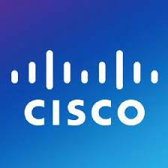

Recent breaches in the headlines
Russian state-sponsored APT28 hackers have been deploying a custom-made malware named ‘Jaguar Tooth’ on Cisco IOS routers
Why is cyber crime growing?
Faced large data breach end of 2022 and are facing legal claims
T Mobile disclosed their 2nd data breach of the year and their 7th since 2018
More apps are available
More places to sell data
Data stored in more places
More people can access data
We are living in an age of digitisation – Many things are interconnected
Outsourcing giant Capita suffered a cyber attack giving hackers access to internal and customer data
Russian state sponsored hackers have been deploying custom made malware on Cisco IOS routers
4.3 Million records breached in April 2023
Notes:
Foxtons - Breached in October, thousands of leaked customer data appeared on the dark web in February 2021 – Source: https://propertyindustryeye.com/thousands-of-customers-financial-details-held-by-foxtons-allegedly-leaked/
Channel Nine – The broadcaster said it was unable to air several shows at the end of March, including Weekend Today. Nine said it was investigating whether the hack was "criminal sabotage or the work of a foreign nation“ – Source: https://www.bbc.co.uk/news/world-australia-56554641
FatFace – UK retailer has come under fire for how it’s responded to the breach which saw customer information and partial card information leaked in early 2021 – Source: https://www.infosecurity-magazine.com/news/fatface-faces-customer-anger/
Clubhouse – New social media app still in the early stages of launching, claims it’s been hacked and the 1.3m users’ information has leaked online, something that their CEO denied this week – Source: https://news.sky.com/story/clubhouse-ceo-denies-company-was-hacked-after-user-data-leak-12273306
Facebook - At least 87 million records breached (though likely many more)
Date disclosed: March 17, 2018
Who can forget the data scandal that rocked Facebook in March 2018? At that time, reports emerged of how a political data firm called Cambridge Analytica collected the personal information of 50 million Facebook users via an app that scraped details about people’s personalities, social networks, and engagement on the platform.
NHS still have issues today following the WannaCry outbreak last year
Colonial Pipeline
Apple a bug allowed admin access to systems without a password. (Last year)
TeamViewer was attacked in Autumn 2019 – only disclosed in May 2019
SolarWinds - Earlier this year, hackers secretly broke into Texas-based SolarWind's systems and added malicious code into the company's software system. The system, called "Orion," is widely used by companies to manage IT resources. Solarwinds has 33,000 customers that use Orion, according to SEC documents.
Manchester United – hacked earlier in 2021, but fan data is safe

Slide 5




Cyber security in the news
Cyber criminals aren’t just going after the big-name organisations anymore
More
and more
Costs
are rising
Are you
next?
The true
impact
1 in 2 organisations experienced a successful cyber attack in the past 3 years
A new business gets hit by ransomware every 14 seconds
The annual cost of a data breach globally hit £3.5million
Whilst large organisations are still hit, 43% of all cyber attacks are now on SME organisations
60% of SME owners don’t think they are a target
60% of those who suffer a breach go out of business within six months
Sources: SoSafe, Cobalt, Cloudwards 2019; CyberSecurity Ventures, 2019
Notes:
2,200 attacks each day which breaks down to nearly 1 cyberattack every 39 seconds.
40% of UK businesses suffered a cyber attack in 2022 – source AAG and gov.uk
Only 14% of SMEs are prepared

Slide 6
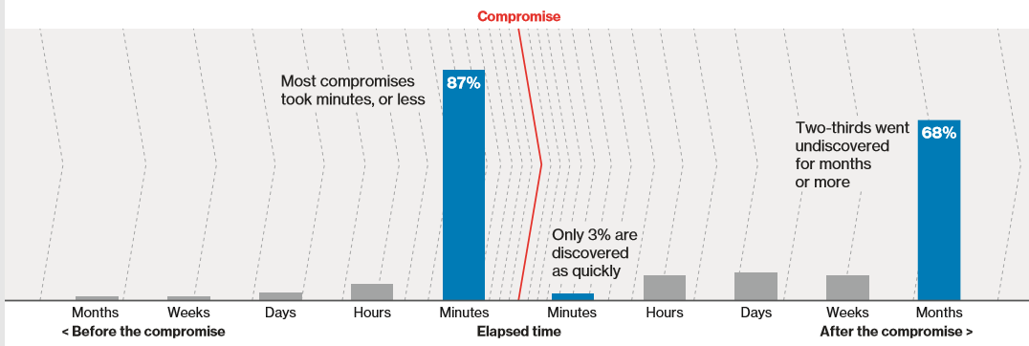
The true cost of an attack
In just minutes, a breach can damage customer trust for a lifetime
408Million
records breached in
2022
86%
of attacks are motivated by
Financial gain.
$8 trillion
cost of cybercrime in 2023. Rising to $10.5 in 2025
95%
of all attacks are caused by human error
Breach Discovery takes on average 197 days
Verizon Data Breach Investigations Report 2018
Sources: IT Pro, 2020; Bitdefender, 2019; FinTech News, 2020; Cybint Solutions, 2020
Notes:
Source for $8trillion cost – forbes. Was $3trillion in 2015

Slide 7
Question
Which areas are you most concerned about in 2023?

Slide 8
Trends for 2023
What Fifosys believe to be the main risks of 2023
Phishing
emails
Vulnerability
Exploitation
Ransomware
Will be back
Vendor
attacks
Phishing will continue to be the most common form of attack due to the ease and advances in tech
Due to the rise in ML and AI, finding and exploiting vulnerabilities in now easier
Evolving “next gen” ransomware is predicted – The next Wannacry
There will be an increased attack on vendors, MSPs, suppliers, CSPs who will potentially have priviledged access to clients
Highest rate of mobile phishing was in 2022
Patching process needs to be more aggressive
Malware too
One large CSP was a victim of this last year
Notes:
3.8m emails – As vaccines started to roll out, COVID-19 featured in a variety of malicious campaigns including email spam, BEC, malware, ransomware, and malicious domains. Over 3.8m emails were sent out across Q3 2020 that mentioned ‘COVID-19’ but were a threat to users. Source: https://www.trendmicro.com/vinfo/us/security/news/cybercrime-and-digital-threats/coronavirus-used-in-spam-malware-file-names-and-malicious-domains
667% spike – Be vigilant, are you using any sort of spam filter on your inbox? Only open emails you trust. Source: https://www.infosecurity-magazine.com/news/covid19-drive-phishing-emails-667/
One in five have received no training – The pandemic has shifted us all to working from home, but is it relaxing working attitudes and practices? One in five UK workers surveyed by Hayes Connor admitted to receiving no training on cyber security, GDPR and data handling, which significantly increases the risk of a breach. Source: https://www.hayesconnor.co.uk/news-and-resources/reports/data-breach-statistics-2020/
90% of breaches – Training is key to eliminating threats. It won’t make any organisation 100% secure, but it goes a long way. Source: https://www.cybersecurityintelligence.com/blog/90-of-breaches-are-caused-by-human-error-4820.html
Malicious Sites – Threats aren’t just coming via targeted methods, as research found the over 4,000 malicious COVID-related websites popped up across the first few months of lockdown. Source: https://securityboulevard.com/2020/12/cybercrime-expected-to-rise-at-an-unprecedented-rate-in-2021
22,000 were taken offline – The National Cyber Security Centre defended the UK from an average of 60 attacks per month during a year (Sep 2019 – Aug 2020). They launched the pioneering Suspicious Email Reporting Service with the City of London Police, who received 2.3 million emails reported by the public, which led to the removal of 22,000 malicious URLs. Source: https://www.ncsc.gov.uk/news/ncsc-defends-uk-700-cyber-attack-national-pandemic
Frequency of attacks – UK businesses lost over £6.2 million to cyber scams over the past year - with a 31% increase in cases during the height of the pandemic. Source: https://www.securitymagazine.com/articles/93722-uk-sees-a-31-increase-in-cyber-crime-amid-the-pandemic
148% Ransomware increase – As mentioned earlier, ransoms are now ranging up to £1.5m and not only is the cost rising, but the volume of attacks is also increasing. We saw a 148% rise in March during the start of the first lockdown in the UK, with set industries (finance and healthcare being two notable ones) being first in cyber criminals’ crosshairs. Source: https://www.carbonblack.com/blog/amid-covid-19-global-orgs-see-a-148-spike-in-ransomware-attacks-finance-industry-heavily-targeted/

Slide 9

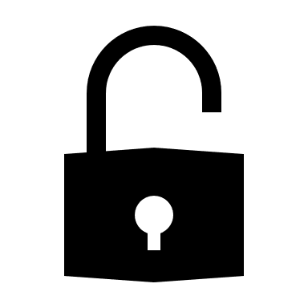
Attacks are evolving
Not only are attacks becoming more complex, but they’re also costing more too
Cloud environments are now being targeted directly
Machine learning can now be used to deploy phishing attacks.
Open Source vulnerabilities were found in 84% of code bases.
Ransoms are rising and now can range from £1,000 up to £1,500,000
Crime as a Service will help the hackers instigate attacks (RaaS, Maas, SEaaS)
IOT devices are being exploited due to weak security
Notes:
Advances in technology have made it easier for hackers to phish. They can use readily available digital graphics, apply social engineering data, and a vast array of phishing tools, including some automated by machine learning.
According to Synopsys researchers, at
Sources: Citrix, 2021; APWG’s Phishing Activity Trends Report for Q3 2020 , 2020; Positive Technologies , 2021; Forbes, 2020
least one open source vulnerability was found in 84% of code bases

Slide 10
The main threats and types of attacks
Technology-focused
User-focused
Denial of Service (DoS) and Distributed Denial of Service (DDoS)
Man in the Middle Attacks (MitM)
Eavesdropping Attacks
Drive-by attack
Cross-Site Scripting
Phishing and Spear Phishing
Password Attacks
Whaling
Malware
Ransomware
Known
Zero Day exploits
Recycled Threats
? (Unknown Unknowns)
?
Unknown
Notes:
Security company Malwarebytes recently produced a report on the biggest threat at the moment which is Ransomware.
40% attacked
The report, which surveyed 540 CIOs, CISOs and IT Directors from companies with an average of 5,400 employees across the U.S., Canada, U.K. and Germany, found that 40% of businesses have experienced a ransomware attack in the last year. Of these victims, more than a third lost revenue and 20% had to stop business completely.
58% of UK companies pay up
The report found that many are paying attackers’ ransoms – even though the consensus is that companies should never comply with attacker demands. In 2016 the FBI said that in no circumstances should individuals or businesses pay to regain access to information.
Explaining why businesses should not pay up, Andy Buchanen said: “[not paying a ransom] is good advice for two reasons: firstly, there is no guarantee that you are going to get access to your data or, in the case that you do, the data could be compromised. The saying goes that there is no honour among thieves, and data held to ransom could well have been corrupted during the process, or backdoors left within it so hackers can regain access into your network at their leisure.” On average, 37% of organisations pay the ransom.
28% lost files
There are consequences to not paying the ransom, with more than one-quarter losing files because they did not pay. This should not come as a surprise – there is rarely a way to decrypt files without the key from the ransomware author. 32% of UK companies lost files after refusing to pay.
34% lost money
The report found that the impact of ransomware attacks was significant among companies that were infected – which points to high-value data being compromised. Globally, 34% of ransomware attacks caused companies to lose revenue due to the inability to access encrypted files.
9 hours spent on remediation
The report found that more than 60% of those surveyed took more than 9 hours to remediate the impact of an attack.
60% demand over $1,000
Nearly 60% of all ransomware attacks in the enterprise demanded over $1,000. Over 20% of attacks asked for more than $10,000, 1% even asked for over $150,000.
3.5% fear loss of life
An amazing stat to come out of the Malwarebytes report was that 3.5% of companies said lives were at stake because of ransomware’s debilitating effects.
63% experienced severe downtime
Ransomware disrupts – that's a fact. 63% of those surveyed spent more than an entire business day trying to fix endpoints.
4% confident in dealing with ransomware
One of the more worrying stats made all the more worrying from the preceding figures in this article. Just 4% of organisations are ‘very confident’ in their ability to stop ransomware. 78% said they were somewhat or fairly confident, even though 80% of companies have been the victim of a cyber attack in the last 12 months. One in five were either not confident at all or only minimally confident is their ability to deal with ransomware.
“The results from this survey further emphasize that any business in any region is incredibly vulnerable to ransomware,” said Marcin Kleczynski, CEO of Malwarebytes. “Cybercriminals are increasing their use of ransomware in their attack strategies globally, causing business disruption, loss of files and wasted IT man-hours. To stay safe, businesses must invest heavily in both employee education and technology. We are thrilled to be able to give companies a solution that can thoroughly protect them against ransomware threats.”

Slide 11
Question
How confident are you your users are aware of these Cyber threats?
Notes:
Are you going to operate differently? We have found several businesses in this sector reduce office space.
How are you going to get your staff to come back full time in the office? Or are you no longer planning to do this?

Slide 12







Technical Solutions
Networks have expanded, has your security adjusted accordingly?
Areas to invest in
Understanding threat sources
PAM/PIM
Training
Next-generation security appliances/software
Multi-Factor Authentication / Single Sign On
Security / vulnerability audits
Password management
Dark web monitoring
Web filtering / Mail filtering
Zero trust configurations
Proactive monitoring O365 / SOC / SIEM
Home networks
Education
Credentials
Patching
Remote access
Notes:
As a responsible company, you must protect your data. Because, with the advent of the cloud, the way we use and share data has changed so dramatically that we constantly need new methods for securing data.
The key is identifying where the threats come from. i.e. how does data get into your environment?
Next, you can use this information to start mitigating the risks to your systems. If you cannot cover them all then prioritise based on likelihood and impact.
You also need to work with your staff to ensure they are acting correctly.
There is no point in securing a system if someone uses the system in an insecure way (sharing passwords, leaving systems unlocked, printing etc).
Investment may be required – Where is it most valuable?
﻿
No single solution will eliminate the threat

Slide 13


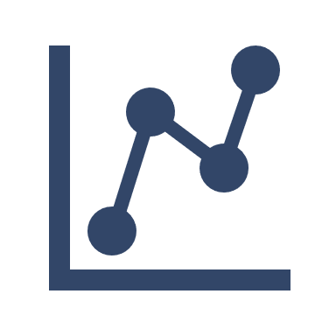



Operational Solutions
Group your data
Stop thinking it all has the same importance
Access
Corporate vs Internal – are your access settings up-to-date?
Retention and Management
Keep critical data organised, so it’s always accessible and safe
What steps can you take?
Evidence
Keep track of what you’ve done and where data is stored
Compliance / Accreditation
Ensure systems remain compliant. Invest in security accreditations (ISO, CE+)
Education and Training
Reduces the risk, whilst not letting panic set in if an attack does happen

Slide 14
Cyber Security
Baseline
Advanced Endpoint Protection | Patch Management | Business-Grade Firewall | Backup & Disaster Recovery
Annual Security Assessment | Business Grade Anti-Spam | Password Policy | Security Awareness Training
Multi-Factor Authentication | Dark Web Monitoring | Log Management | Secure Web Gateway
Mobile Device Security | Encryption of Data | Security and Risk Policies | Virtual CISO
RAG status of current baseline security posture

Slide 15
Question
Are you planning on investing in this area to address the challenges?

Slide 16
The three pillars of data security
People
All employees should be aware of their role in preventing cyber crime
Process
Cyber threats change quickly. Processes need to be continually reviewed and adapted
Technology
By identifying threats, you can look at the controls to put in place and the technology you’ll need
Cyber Security
Notes:
An effective plan to deal with cyber security involves implementing controls based on 3 pillars
Cyber response plan
BC/DR

Slide 17
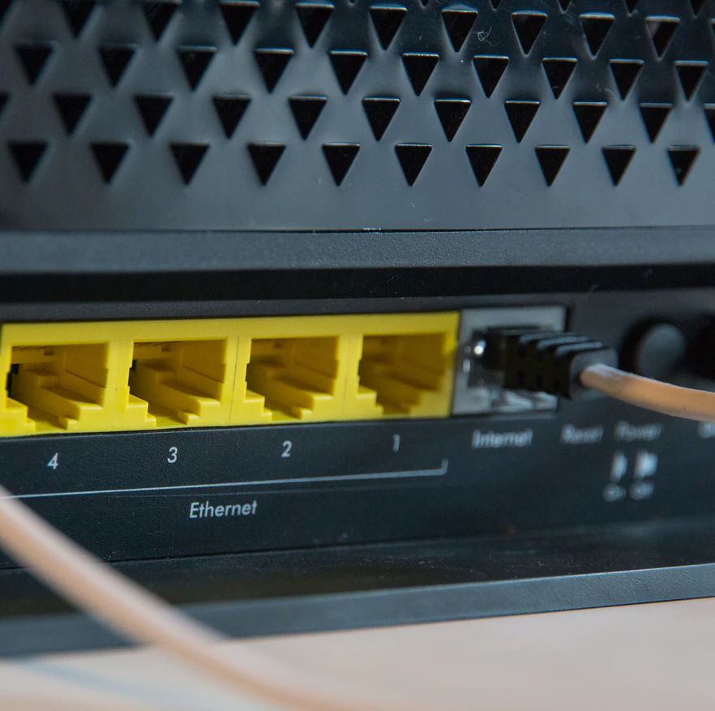
What happens if you are attacked?
Even with all the preventative measures in place, the worst can still happen.

Slide 18




Plan your recovery
Plan ahead, act before it’s too late
Act before you need to
The right process ensures a smooth recovery
Disaster Recovery
Back up often, recover faster and test regularly
Business Continuity
Plan for when IT is down – train staff, communicate and don’t panic
Risk-Based Approach
What’s important and does everything need protecting?

Slide 19
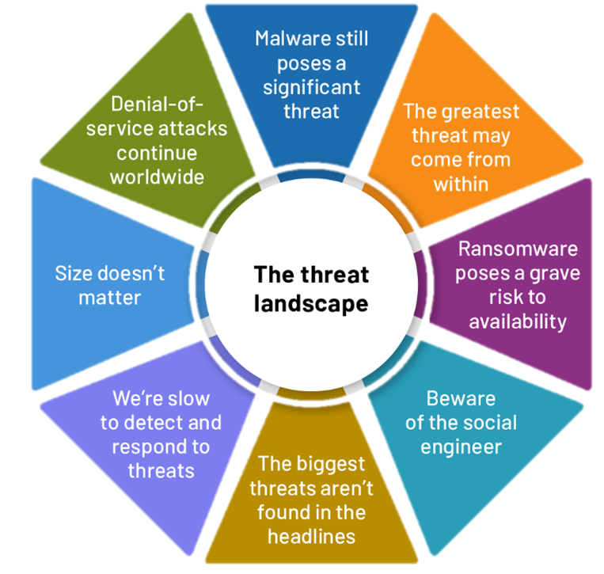
Summary
Use a proven, multi-layered approach to security
Identify the threat sources
Identify where investment is required or improvements can be made
Educate users and yourself
Disable what is not needed
Multiple backups
Manage and prioritise your data
Don’t neglect patching
Plan your recovery before you need to
Source: IDC, 2018

Slide 20


Questions?
Get in touch to learn more about how we can partner with you
For more information:
www.Fifosys.com
m.patel@fifosys.com
j.moss@fifosys.com
Fifosys
@Fifosys

